Slide 1
Movie Recommendation System
Submitted By :
Ganesh Gajengi

Slide 2
Introduction
Recommendation systems produce a ranked list of items on which a user might be interested, in the context of his choice of an item
Movie recommendation systems are pivotal components of modern digital platforms, enriching user experiences by offering tailored suggestions based on individual preferences and behavior.
These systems employ various techniques such as collaborative filtering, content-based filtering, and hybrid approaches to analyze user data and provide relevant recommendations
Their significance extends beyond mere convenience, significantly influencing user engagement, retention, and overall satisfaction with streaming platforms and online movie services..

Slide 3
Objective
The primary goal of this project is to develop an efficient movie recommendation system using collaborative filtering techniques, specifically focusing on k-Nearest Neighbors (KNN) and Singular Value Decomposition (SVD) matrix factorization.

Slide 4
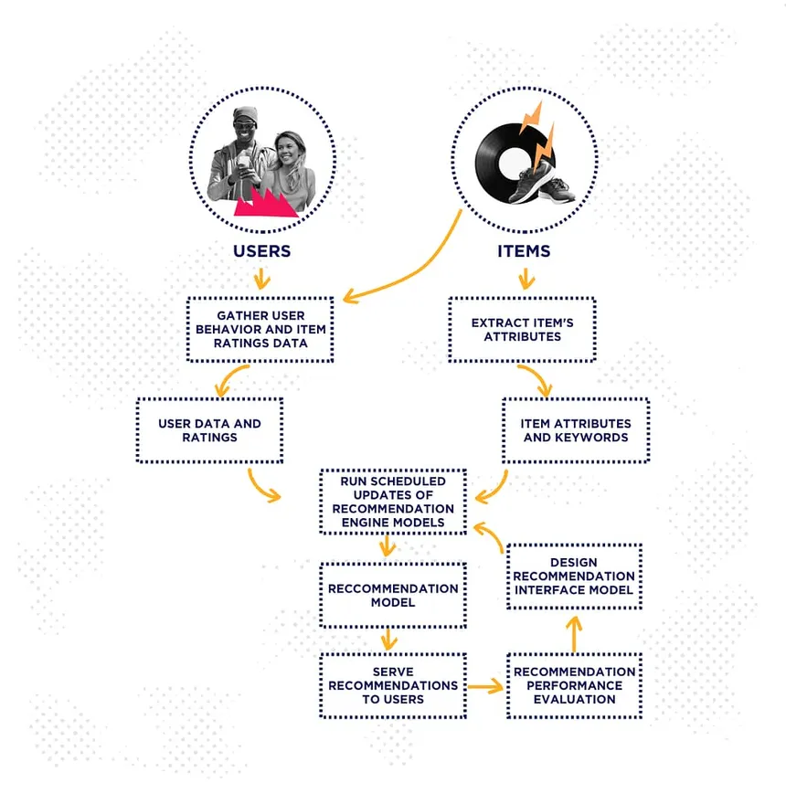
Process Flow

Slide 5





Tools and Platform used
Tools: Python
Platform : Jupyter Notebook
Library Used : Numpy, Pandas, Matplot

Slide 6
Challenges
Recommendation systems encounter various hurdles that impact their performance and effectiveness in providing accurate and relevant suggestions to users.
Limited availability of user-item interaction data, leading to sparse matrices and difficulties in generating accurate recommendations, especially for niche or less popular items.
Difficulty in providing recommendations for new users or items with insufficient historical data, resulting in suboptimal suggestions and reduced user satisfaction.

Slide 7

Data Description
Source : Kaggle
UserId | MovieId | Rating | Timestamp
1 | 1 | 4.0 | 964982703
1 | 3 | 4.0 | 964981247
1 | 6 | 4.0 | 964982224
1 | 47 | 5.0 | 964983815
1 | 50 | 5.0 | 964982931
Rating Dataset (100836,4)

Slide 8
Data Description
MovieId | Title | Genres
1 | Toy Story (1995) | Adventure|Animation|Children|Comedy|Fantasy
2 | Jumanji (1995) | Adventure|Children|Fantasy
3 | Grumpier Old Men (1995) | Comedy|Romance
4 | Waiting to Exhale (1995) | Comedy|Drama|Romance
5 | Father of the Bride Part II (1995) | Comedy

Slide 9
Exploratory Data Analysis
Number of ratings: 100836
Number of unique movieId's: 9724
Number of unique users: 610
Average number of ratings per user: 165.3
Average number of ratings per movie: 10.37

Slide 10
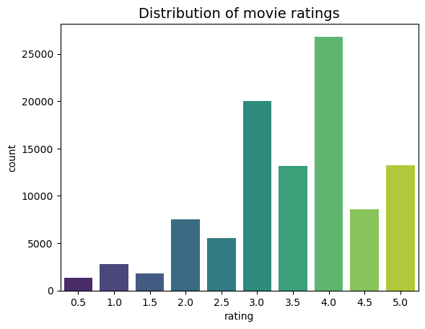
Distribution Of Movie Rating

Slide 11
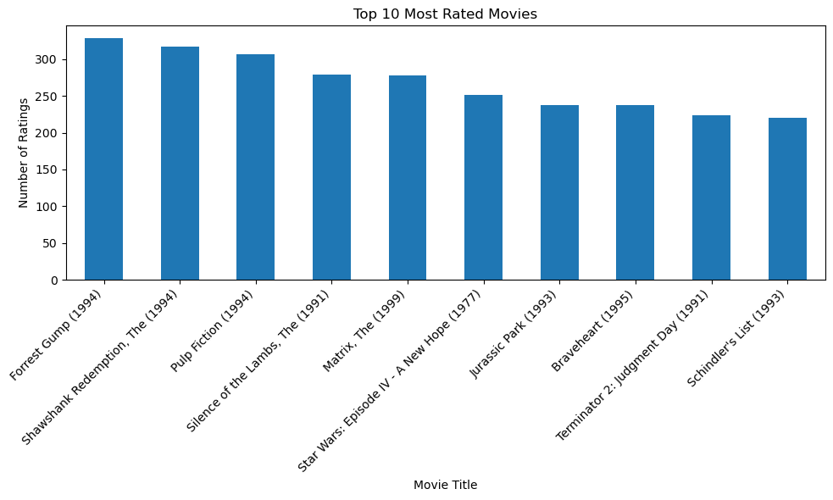
Movies Frequently Rated

Slide 12
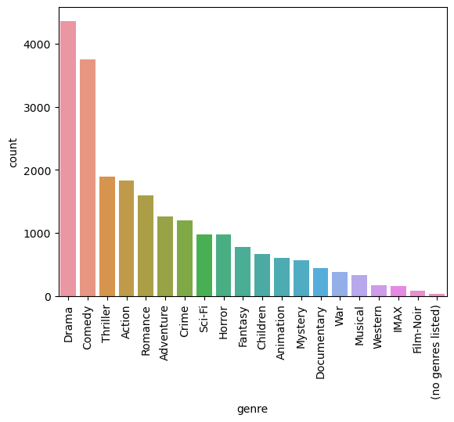
A Glimpse at Movie Genres

Slide 13
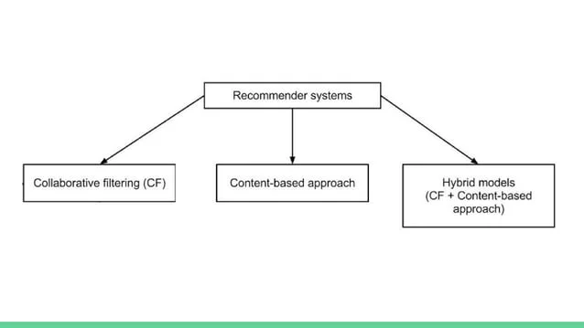
Data Pre-Processing Technique used Hybrid ModelFiltering

Slide 14
Hybrid Approach
We Attempt to hybridize collaborative filtering and content based recommendation. Item similarity measure used in content based recommendation is learned from collaborative social network of users
In content based recommendation every item is representes by a feature vector. The feature hold numeric or nominal value representing certain aspect of the item.
A variety of distance measure between the feature vectors may be used to compute similarity of two items

Slide 15
Cold Start Problem
The cold start problem is when there are new users and movies in our matrix that do not have any ratings. In our Movie dataset, all users and movies have at least one rating but in general, it's useful to check which users and movies have few interactions.

Slide 16
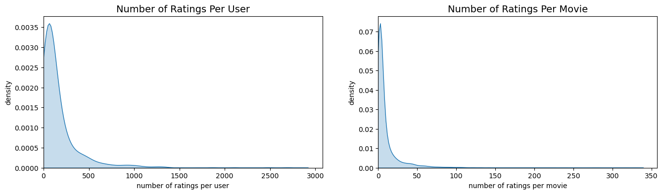
Cold-Start Problem Checking

Slide 17
Handling Cold-start Problem
Collaborative filtering relies solely on user-item interactions within the utility matrix. The issue with this approach is that brand new users or items with no iterations get excluded from the recommendation system. This is called the cold start problem. Content-based filtering is a way to handle this problem by generating recommendations based on user and item features.
First, we need to convert the `genres` column into binary features. Each genre will have its own column in the dataframe, and will be populated with 0 or 1.

Slide 18
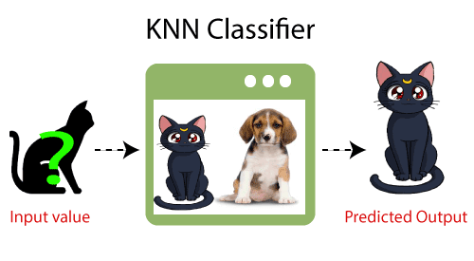
K-nearest Neighbors
K-Nearest Neighbor is one of the simplest Machine Learning algorithms based on Supervised Learning technique.
K-NN algorithm assumes the similarity between the new case/data and available cases and put the new case into the category that is most similar to the available categories.
K-NN algorithm stores all the available data and classifies a new data point based on the similarity. This means when new data appears then it can be easily classified into a well suite category by using K- NN algorithm.
K-NN algorithm can be used for Regression as well as for Classification but mostly it is used for the Classification problems.

Slide 19
Recommendations with k-Nearest Neighbours
Because you watched Toy Story (1995):
Toy Story 2 (1999)
Jurassic Park (1993)
Independence Day (a.k.a. ID4) (1996)
Star Wars: Episode IV - A New Hope (1977)
Forrest Gump (1994) Lion King, The (1994)
Star Wars: Episode VI - Return of the Jedi (1983)
Mission: Impossible (1996) Groundhog Day (1993)

Slide 20
KNN You can also play around with the kNN distance metric and see what results you would get if you use "manhattan" or "euclidean" instead of "cosine".
Because you watched Toy Story (1995):
Toy Story 2 (1999)
Mission: Impossible (1996)
Independence Day (a.k.a. ID4) (1996)
Bug's Life, A (1998)
Nutty Professor, The (1996)
Willy Wonka & the Chocolate Factory (1971)
Babe (1995)
Groundhog Day (1993)
Mask, The (1994)

Slide 21
SVD
The Singular Value Decomposition (SVD) of a matrix is a factorization of that matrix into three matrices.
It has some interesting algebraic properties and conveys important geometrical and theoretical insights about linear transformations.
It also has some important applications in data science.
The SVD of mxn matrix A is given by the formula A = UEV^T

Slide 22
Dimensionality Reduction with Matrix Factorization(SVD)
Because you watched Toy Story (1995):
Home Alone (1990)
Jurassic Park (1993)
Aladdin (1992)
Willy Wonka & the Chocolate Factory (1971)
Back to the Future (1985)
Groundhog Day (1993)
Forrest Gump (1994)
Star Wars: Episode IV - A New Hope (1977)
Princess Bride, The (1987)

Slide 23
Conclusion
The results above are the most similar movies to Toy Story using kNN on our “compressed” movie-factor matrix. We reduced the dimensions down to n_components=20. We can think of each component representing a latent feature such as movie genre.

Slide 24
Thank You

